Slide 1

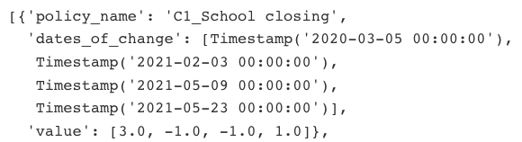
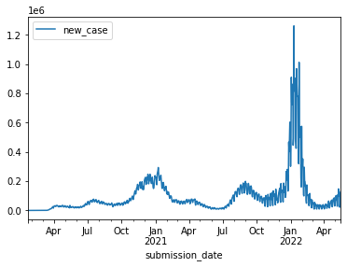
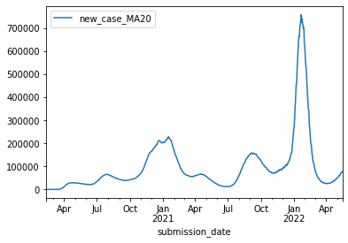
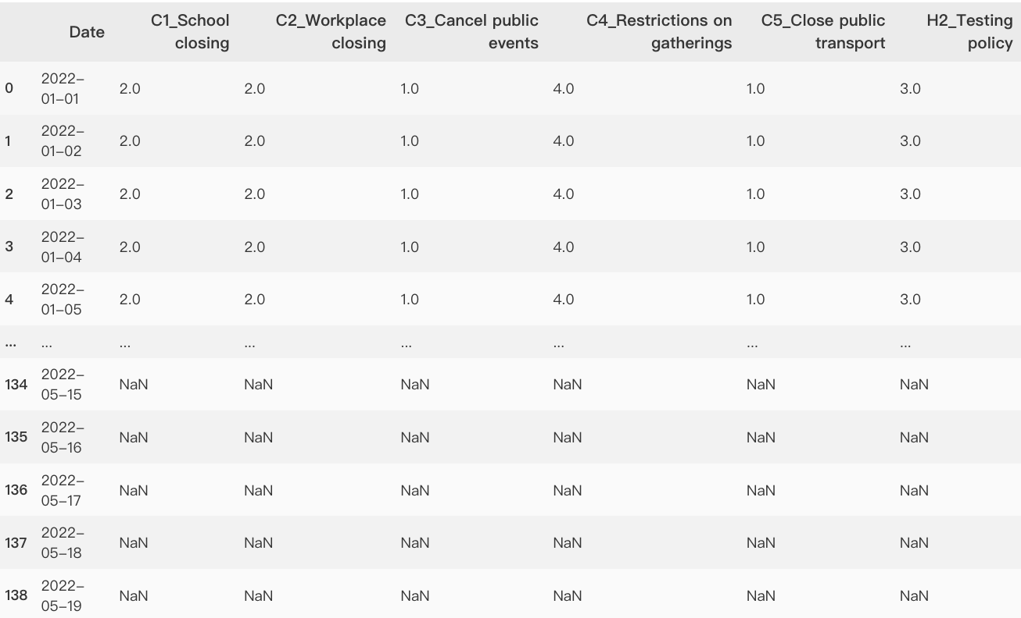
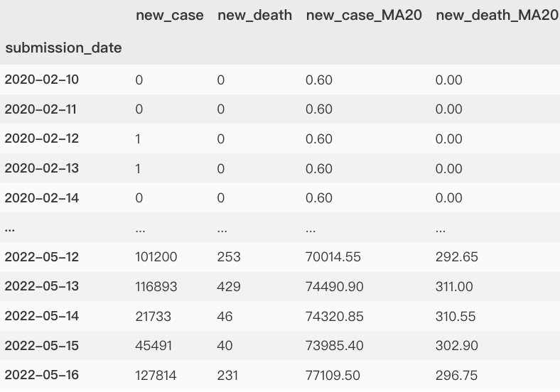
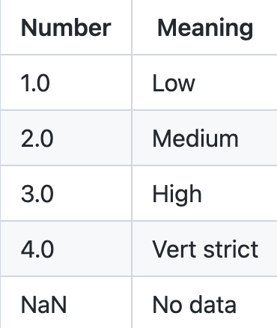
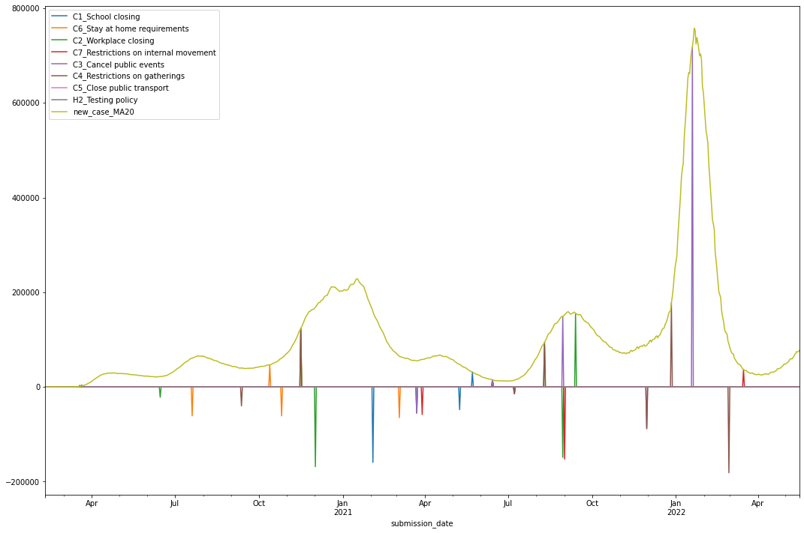
A Case Study of Predicting Policy Changes Using COVID and Policy Data
Chao Cao
Department of Computer Science and Engineering
University of Texas of Arlington
Introduction
Visualization
There are multiple policies issued in respond to the spread of COVID as time passed.
This project utilizes open-source data to visualize, analyze and predict on the relationship between COVID and policy changes.
The results can help policymakers and researchers better understand the trends and causes behind policy changes. The findings have the potential to improve decision-making and inform future policy development.
I calculated the differences of policy strictness and marked the dates as the timestamp s of turning points.
I used the time period of 20 days to make the case data smoothly and flatly.
Dataset
Data Types
Data Sources
Real-time only
Facts only
Flexible only
Clear only
Authoritative organizations (e.g., WHO, CDC)
Fact-checking websites (e.g., Oxford)
Data Statistics
Number of data sources: 2
Number of policies: 817
Number of national policies: 79
Number of focused policies: 17
Number of presented policies: 8
Number of case data: 50760
Data Cleaning
Sort the data by date
Use mean value to replace missing data
Set 20 days as a time period
Drop unnecessary columns to stay focused
The project was finished at UMD, 2022 Spring
All collected and tested data can be found at: https://github.com/HenryVarro666/policy-changes-prediction
Fusion
By combining the two policies and COVID cases graphs together, we can visually analyze COVID and policy information together and get some insights about relationships between them.
Insights
Responses tend to have a one-month lag time
Last peak was caused by the Omicron variant.
Cancel public events and restriction on gathering are helpful when the spreading is fast.

